Slide 1


Objects and JSON
SoftUni Team
Technical Trainers
Software University
http://softuni.bg

Slide 2
Table of Contents
Objects
Definition, properties and methods
Object methods
Iterate over Object Keys
JSON
Value vs Reference Type
Classes

Slide 3
Have a Question?
sli.do
#tech-fund

Slide 4

Objects
Definition, Properties and Methods

Slide 5
What are Objects ?
Collection of related data or functionality
Consists of several variables and functions called properties and methods
In JavaScript, at run time you can add and remove properties of any object
Object name
Property name
let obj = { name:'Peter', age: 20 }
console.log(obj.name) //Peter
Property value

Slide 6
Object Definition
We can create an object with an object literal, using the following syntax:
let person = {name:'Peter', age: 20, hairColor: 'black'}
We can define empty object and add the properties later
let person = {}
person.name ='Peter'
person["lastName"] = 'Parker'
person.age = 20
person.hairColor = 'black'
You can access and set properties using both ways

Slide 7
Object Methods
Functions within a JavaScript object are called methods
We can define methods using several syntaxes:
We can add a method to an already defined object
let person = { sayHello : function() {
console.log('Hi, guys')
} }
let person = {
sayHello() {
console.log('Hi, guys')
}
}
let person = { name:'Peter', age: 20 }
person.sayHello = () => console.log('Hi, guys')

Slide 8
The Object Methods
Methods:
Object.entries() – returns array of all properties and their values of an object
Object.keys() – returns array with all the properties
Object.values() – returns array with all the values of the properties
Object.entries(cat) //[['name', 'Tom'], ['age', 5]]
Object.keys(cat) //['name', 'age']
Object.values(cat) //['Tom', 5]

Slide 9
Iterate through Keys
Use for-in to loop through the keys:
in loops through the properties
let obj = { name:'Peter', age:'18', grade:'5.50' } for (let prop in obj) { console.log(`${prop}: ${obj[prop]}`); }
Returns the value of the property

Slide 10
Problem: Person Info
Create a person object that has first name, last name and age. Print the entries of a given object.
Input
Output
Peter
Pan
20
firstName: Peter
lastName: Pan
age: 20
Input
Output
Jack
Sparrow
unknown
firstName: Jack
lastName: Sparrow
age: unknown

Slide 11
Solution: Person Info
Create a Person object
Set properties first name, last name and age
Get the entries. Loop through them and print them
//TODO: create the object and set the properties let entries = Object.entries(person); for (let [ key, value ] of entries) { console.log(`${key}: ${value}`); }
Check your solution here: https://judge.softuni.bg/Contests/1323

Slide 12
Problem: City
Create a City object which will hold area, population, country and postcode. Loop through all the keys and print them with their values
Input
Output
Sofia
492
1238438
Bulgaria
1000
name -> Sofia
area -> 492
population -> 1238438
country -> Bulgaria
postCode -> 1000

Slide 13
Solution: City
Create a City object
Set the properties
Loop through the entries and print them
//TODO: create the city object and set the properties for (let prop in city) { //TODO: print in appropriate format }
Check your solution here: https://judge.softuni.bg/Contests/1323

Slide 14

JSON
JavaScript Object Notation

Slide 15
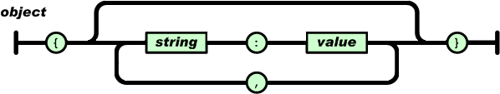
What is JSON
JSON stands for JavaScript Object Notation
Open-standard file format that uses text to transmit data objects
JSON is language independent
JSON is "self-describing" and easy to understand

Slide 16
JSON Usage
Exchange data between browser and server
JSON is a lightweight format compared to XML
JavaScript has built in functions to parse JSON so it's easy to use
JSON uses human-readable text to transmit data

Slide 17
JSON Example
Brackets define a JSON
Keys and values separated by :
{
"name": "Peter",
"age": 25,
"grades": {
"Math": [2.50, 3.50],
"Chemestry": [4.50]
}
}
Keys are in double quotes
It is possible to have object in object
In JSON we can have arrays

Slide 18
JSON Methods
We can convert JavaScript object into JSON string using JSON.stringify(object) method
We can convert JSON string into JavaScript object using JSON.parse(text) method
let text = JSON.stringify(obj)
let obj = JSON.parse(text)

Slide 19
Problem: Convert to Object
Write a function that receives a string in JSON format and converts it to object
Print the entries of the object
Input
'{"name": "George", "age": 40, "town": "Sofia"}'
Output
name: George
age: 40
town: Sofia

Slide 20
Tips: Convert to Object
Use JSON.parse( ) method to parse JSON string to an object
Use Object.entries( ) method to get object's properties names and values
Loop through the entries and print them
function solve(json){ //TODO: use the tips to write the function }

Slide 21
Solution: Convert to Object
function solve(json) { let person= JSON.parse(json);
let entries = Object.entries(person);
for (let [key, value] of entries) {
console.log(`${key}: ${value}`);
}
}
Check your solution here: https://judge.softuni.bg/Contests/1323

Slide 22
Problem: Convert to JSON
Write a function that receives first name, last name, hair color and sets them to an object.
Convert the object to JSON string and print it.
Input
'George', 'Jones', 'Brown'
Output
{"firstName": "George", "lastName": "Jones", "hairColor": "Brown"}

Slide 23
Tips: Convert to JSON
Create an object with the given input
Use JSON.stringify( ) method to parse object to JSON string
Keep in mind that the property name in the JSON string will be exactly the same as the property name in the object
function solve(name, lastName, hairColor){ //TODO: use the tips and write the code }

Slide 24
Solution: Convert to JSON
function solve(firstName, lastName, hairColor){
let person = {
firstName,
lastName,
hairColor
}
console.log(JSON.stringify(person));
}
Check your solution here: https://judge.softuni.bg/Contests/1323

Slide 25
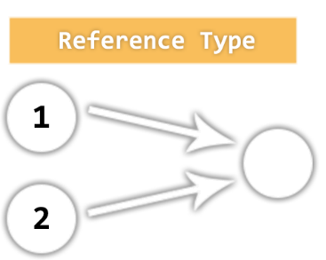
Value vs. Reference Types
Memory Stack and Heap

Slide 26
Value vs. Reference Types

Slide 27
Value Types
Value type variables hold directly their value
Each variable has its own copy of the value
Stack
a
let a = 42;
let b = 24;
let result = true;
42
(4 bytes)
b
24
(4 bytes)
result
true
(1 byte)

Slide 28
Value Types Example
let a = 4 // а = 4
let b = a // b = 4
console.log(a + b)// 8
b = doubleNumber(b)// b = 10
console.log(a + b) // 14
Each variable has its own value
When we pass variables as parameters we are passing copy of their values
You must return the new value
let doubleNumber = (num) => return num *= 2

Slide 29
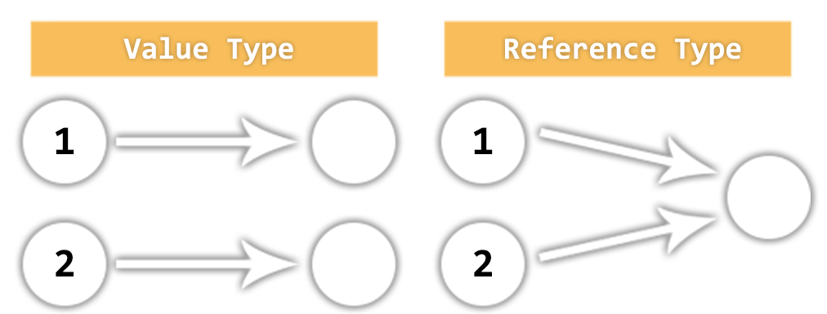
What is Reference Type ?
Object is not the only reference type in JavaScript
Arrays are also regular objects
Variables assigned with non-primitive values are given a reference to the memory address with that value
Many variables can reference the same object
Operations on any variable modify the same data

Slide 30
Reference Type Example
function test() {
let person = { name: 'Peter' };
let obj = person;
console.log(person.name);
changeName('object', obj);
console.log(person.name);
}
function changeName(name, obj){
obj.name = name;
}
Reference is passed to the function
The function is accessing the object directly, there is no need of return.

Slide 31
Reference vs Value Example: Value Types
function solve(){
let num = 5;
increment(num, 15);
console.log(num);
}
function increment(num, value){
num += value;
}
num = 5

Slide 32
Reference vs Value Example: Reference Types
function solve(){
let nums = [ 5 ];
increment(nums, 15);
console.log(nums[0]);
}
function increment(nums, value){
nums[0] += value;
}
num = 20

Slide 33
Class
Classes
Object Models

Slide 34
What are classes
Extensible program-code-template for creating objects
Provides initial values for the state of an object
An object created by the class pattern is called an instance of that class
A class has a constructor - subroutine called to create an object. It prepares the new object for use

Slide 35
Class Declaration
Declaring a class
To declare a class we use the class keyword with the name of the class.
The constructor is a special method for creating and initializing an object
class Student {
constructor(name) {
this.name = name
}
}

Slide 36
Class Example
Creating a class:
Creating an instance of the class:
class Student {
constructor(name, grade) {
this.name = name
this.grade = grade
}
}
this keyword is used to set a property of the objects to a given value
let student = new Student('Peter', 5.50)

Slide 37
Functions in a Class
Classes can also have functions as property, called methods:
class Dog {
constructor() {
this.speak = () => {
console.log('Woof')
}
}
}
let dog = new Dog()
dog.speak() //Woof
We access the method as a regular property

Slide 38
Problem: Cat
Write a function that receives array of strings in the following format: '{cat name} {age}'
Create a Cat class that receives the name and the age parsed from the input
It should also have a function named "meow" that will print "{cat name}, age {age} says Meow" on the console
For each of the strings provided you must create a cat object.
Input
Output
['Mellow 2','Tom 5']
Mellow, age 2 says Meow
Tom, age 5 says Meow

Slide 39
Tips: Cat
Create a Cat class
Set properties name and age
Set property 'meow' to be a function that prints the result
Parse the input data
Create all objects using class constructor and the parsed input data and store them in an array
Loop through the array using for…of cycle and invoke .meow() method

Slide 40
Solution: Cat
function solve(arr){ //TODO: create the Cat class
let cats = [];
for(let i = 0; i < arr.length; i++){ let catData = arr[i].split(' '); let [name, age] = [catData[0], catData[1]]; cats.push(new Cat(name, age));
}
//TODO iterate through cats[] and invoke .meow() using for…of loop
}
Check your solution here: https://judge.softuni.bg/Contests/1323

Slide 41

Live Exercises

Slide 42

Summary
Objects hold key-value pairs
Access key and value by index in loops
Access value with ['key name']
Access value with obj.key
Use Object Methods such as:
Object.keys
Object.values
Parse and stringify objects in JSON formats

Slide 43
https://softuni.bg/courses/technology-fundamentals

Slide 44













SoftUni Diamond Partners

Slide 45





SoftUni Organizational Partners

Slide 46




Trainings @ Software University (SoftUni)
Software University – High-Quality Education and Employment Opportunities
softuni.bg
Software University Foundation
http://softuni.foundation/
Software University @ Facebook
facebook.com/SoftwareUniversity
Software University Forums
forum.softuni.bg

Slide 47

License
This course (slides, examples, demos, videos, homework, etc.) is licensed under the "Creative Commons Attribution-NonCommercial-ShareAlike 4.0 International" license

